Slide 1
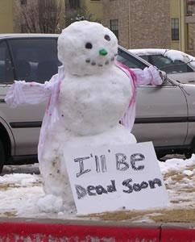
Change of State
This lesson will introduce you to how matter changes state from solid to liquid to gas and vise versa
You will also learn about latent heat and the energy needed to melt and vaporize matter

Slide 2
Learning Goals
By the end of this lesson, you will be able to:
explain heating and cooling curves
define and explain latent heat
solve problems involving latent heat
Explain why water is a special liquid

Slide 3
Success Criteria
Can I:
state and explain latent heat
draw the heating or cooling curve for substances that are heated or cooled
solve latent heat problems
Explain why water is a special liquid

Slide 4
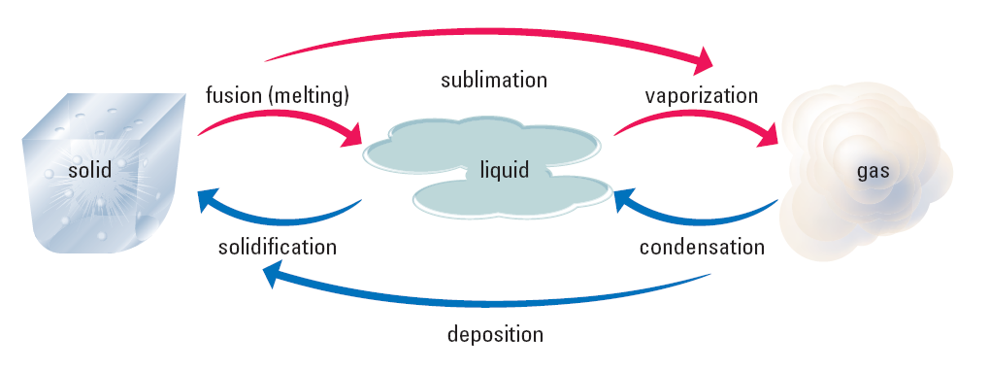
Heating and Cooling
There are three states of matter
Matter can exists in any one of these three states

Slide 5
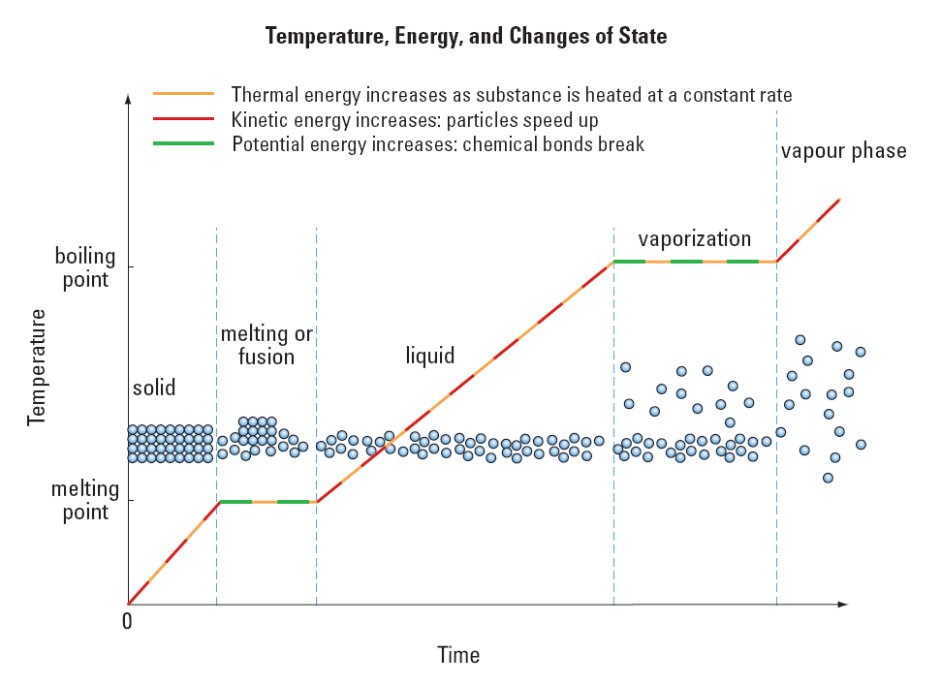

Slide 6
Latent Heat
Latent Heat is the thermal energy that is required to change the state of a substance.
the thermal energy needed to melt 1 kg of a solid
substance is called latent heat of fusion, L_{F}
the thermal energy needed to vaporize 1 kg of a
liquid substance is called latent heat of vaporization, L_{V}

Slide 7
Sample Problem
Gold melts at 1063ºC. It takes 3250 J of energy to melt 50.0 g of gold at this temp. What is the latent heat of fusion of gold?
Sol’n:
m = .050 kg
Q = 3250 J
L_{f} = ?
∴ the latent heat of fusion for gold is 6.5 x 10⁴ J/kg

Slide 8
Sample Problem
What would be the total amount of heat needed to warm a .100 kg solid sample of water (ice) from –30.ºC, through melting, to a final liquid temp of 80.ºC?
Sol’n:
These types of problems are difficult because the
substance changes state.
To make this problem easier, we break it up into three parts.
Part 1: Warming ice from –30.ºC to ice at 0.0ºC.
Part 2: Changing ice from 0.0ºC to water at 0.0ºC.
Part 3: Warming water from 0.0ºC to water at 80.ºC.

Slide 9
Part 1:
To warm the ice, apply the heat transfer eqn.
Part 2:
The heat required to change ice at 0.0ºC to water
at 0.0ºC is given by the latent heat of fusion.

Slide 10
Part 3:
To warm the water, apply the heat transfer eqn.
∴ the total heat needed is 7.3 x 10⁴ J

Slide 11
Water: a special liquid
most solids sink in there respective liquids
water is different – solid water (ice) floats of liquid water
this is because its solid is less dense than its liquid
this is because the shape of a water molecule causes attractive forces between its molecules

Slide 12
HOMEWORK
Read Section 6.4
Review Tutorial 1 pg 292
Questions 1 – 3 pg 293
1 – 8 pg 295

